Slide 1
NatyaDhara
2014-2015

Slide 2
Acting is an art to give a way to one’s inner self to come forward.

Slide 3
Members:
Dr. Sangitamam Parekh,
Jankimam Kotecha,
Rushisir Pandya
Convener:
Vipul Dasani

Slide 4
Special Thanks for helping us in the journey of Natyadhara throughout the year
Chandanimam,
Mitalmam,
Ridhdhimam.

Slide 5
Heartily Thankful for supporting us in serving & presenting Natyadhara
Shree Chetanbhai Dave

Slide 6
Activities undertaken during the year

Slide 7
8/7/2014
Expert Lecture by
Shri Chetanbhai Dave
on
“Drama Art: Expression of Heart”

Slide 8
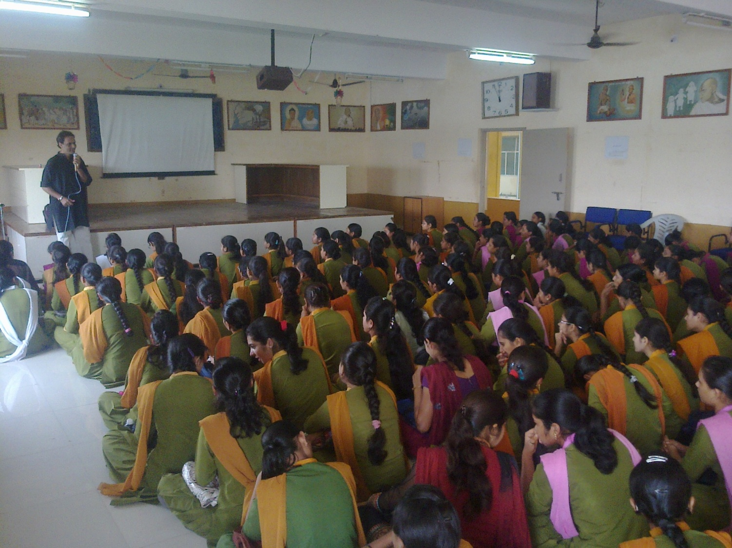

Slide 9
8/7/2014
The experiences shared
by the students in
“NATYA SAFAR”
in last year

Slide 10
22/7/2014
Drama
“Mare Parnavu Nathi”
Directed by:
Shree Chetanbhai Dave
Participants:
Namrata Jadav, Mital Joshi,
Dipa Odedara, Komal Joshi, Janki Sharma

Slide 11
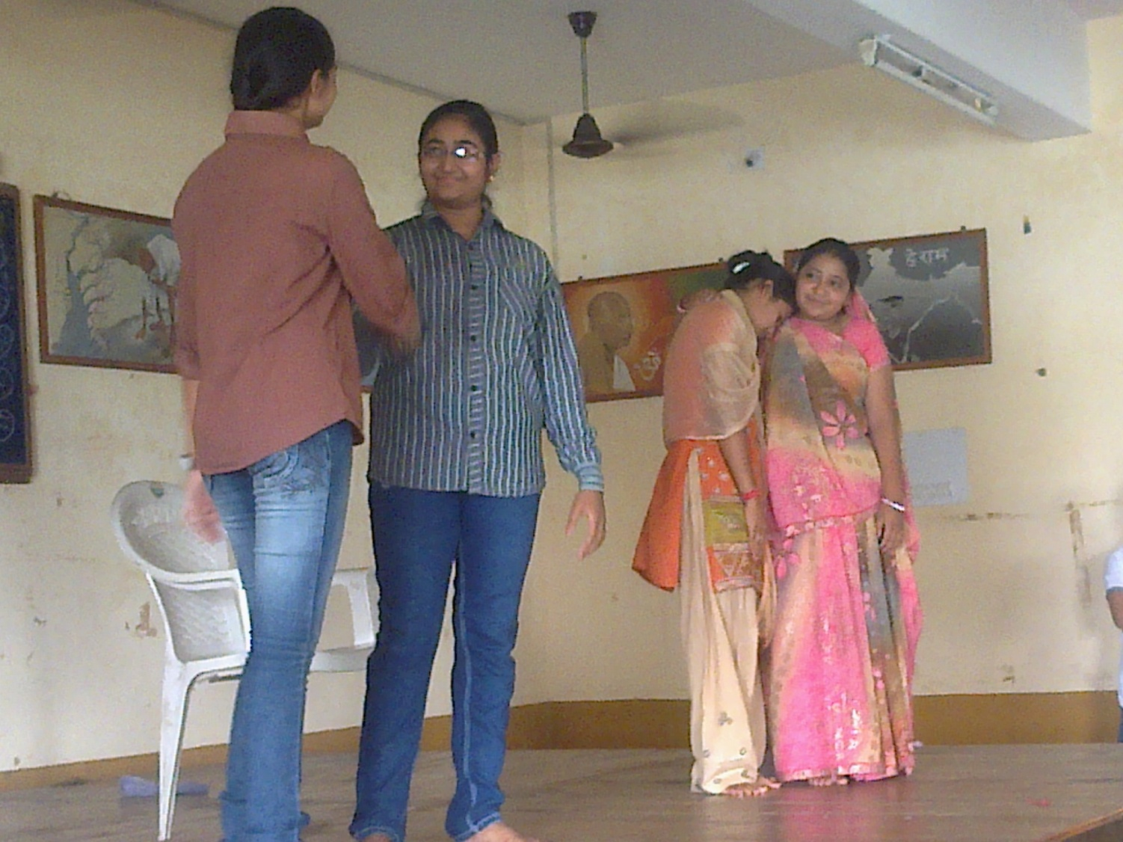

Slide 12
22/7/2014
Story Reshaping Competition:
(A given small story was to be reshaped on the spot)
Winners:
Lakhani Bansi
Vaja Hina
Thanki Varsha

Slide 13
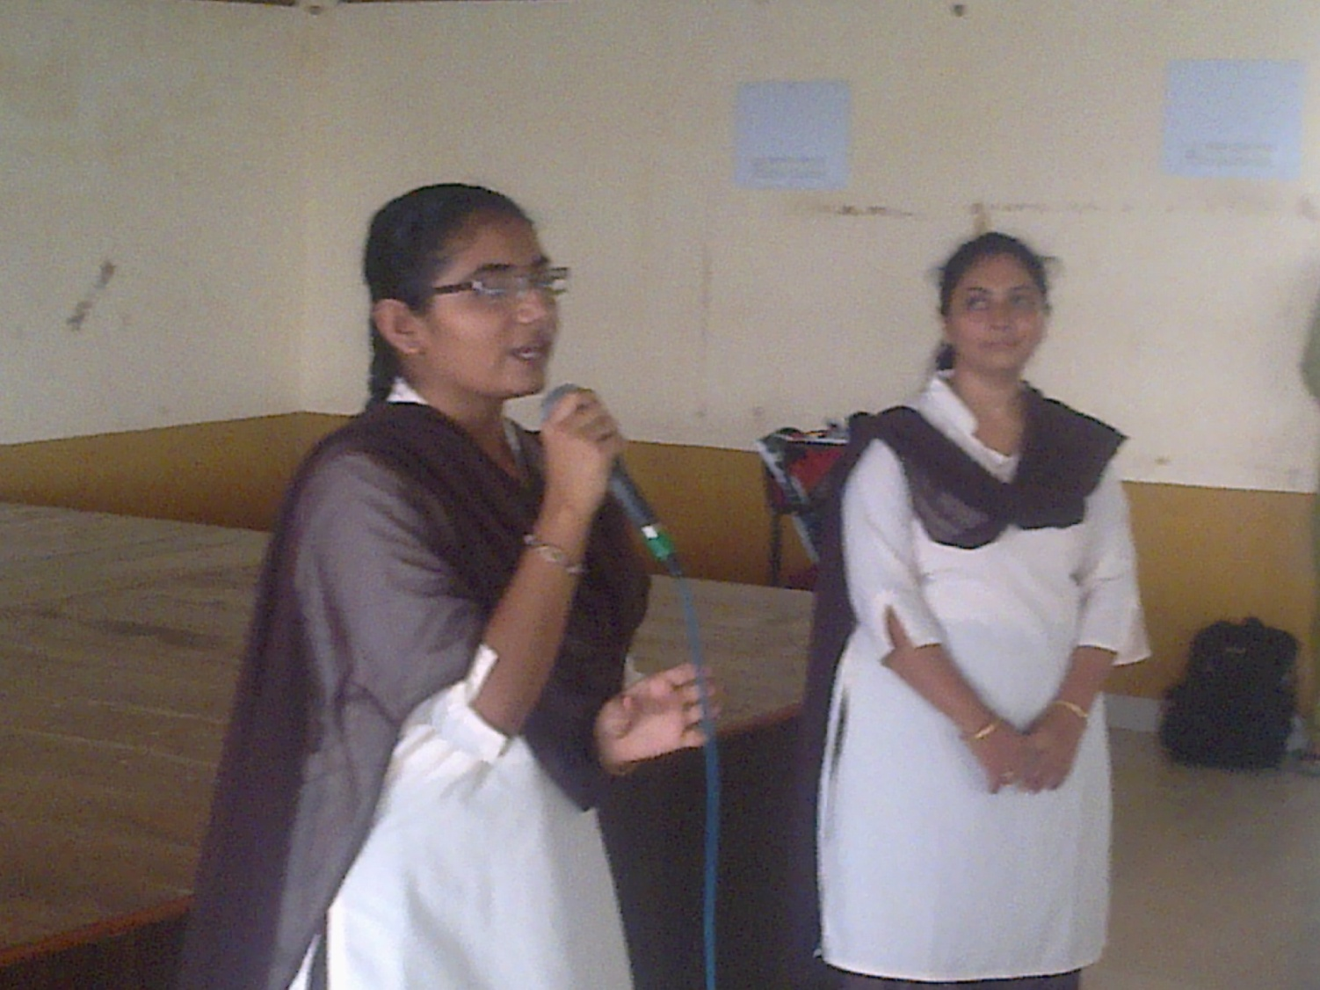

Slide 14
12/8/2014
Independence Day Celebration Competition
(Group activity on a given scene from the Independence Movement History)
Winners:
Vaja Hina & group
Charadva Krupa & group
Atara Divya & group

Slide 15
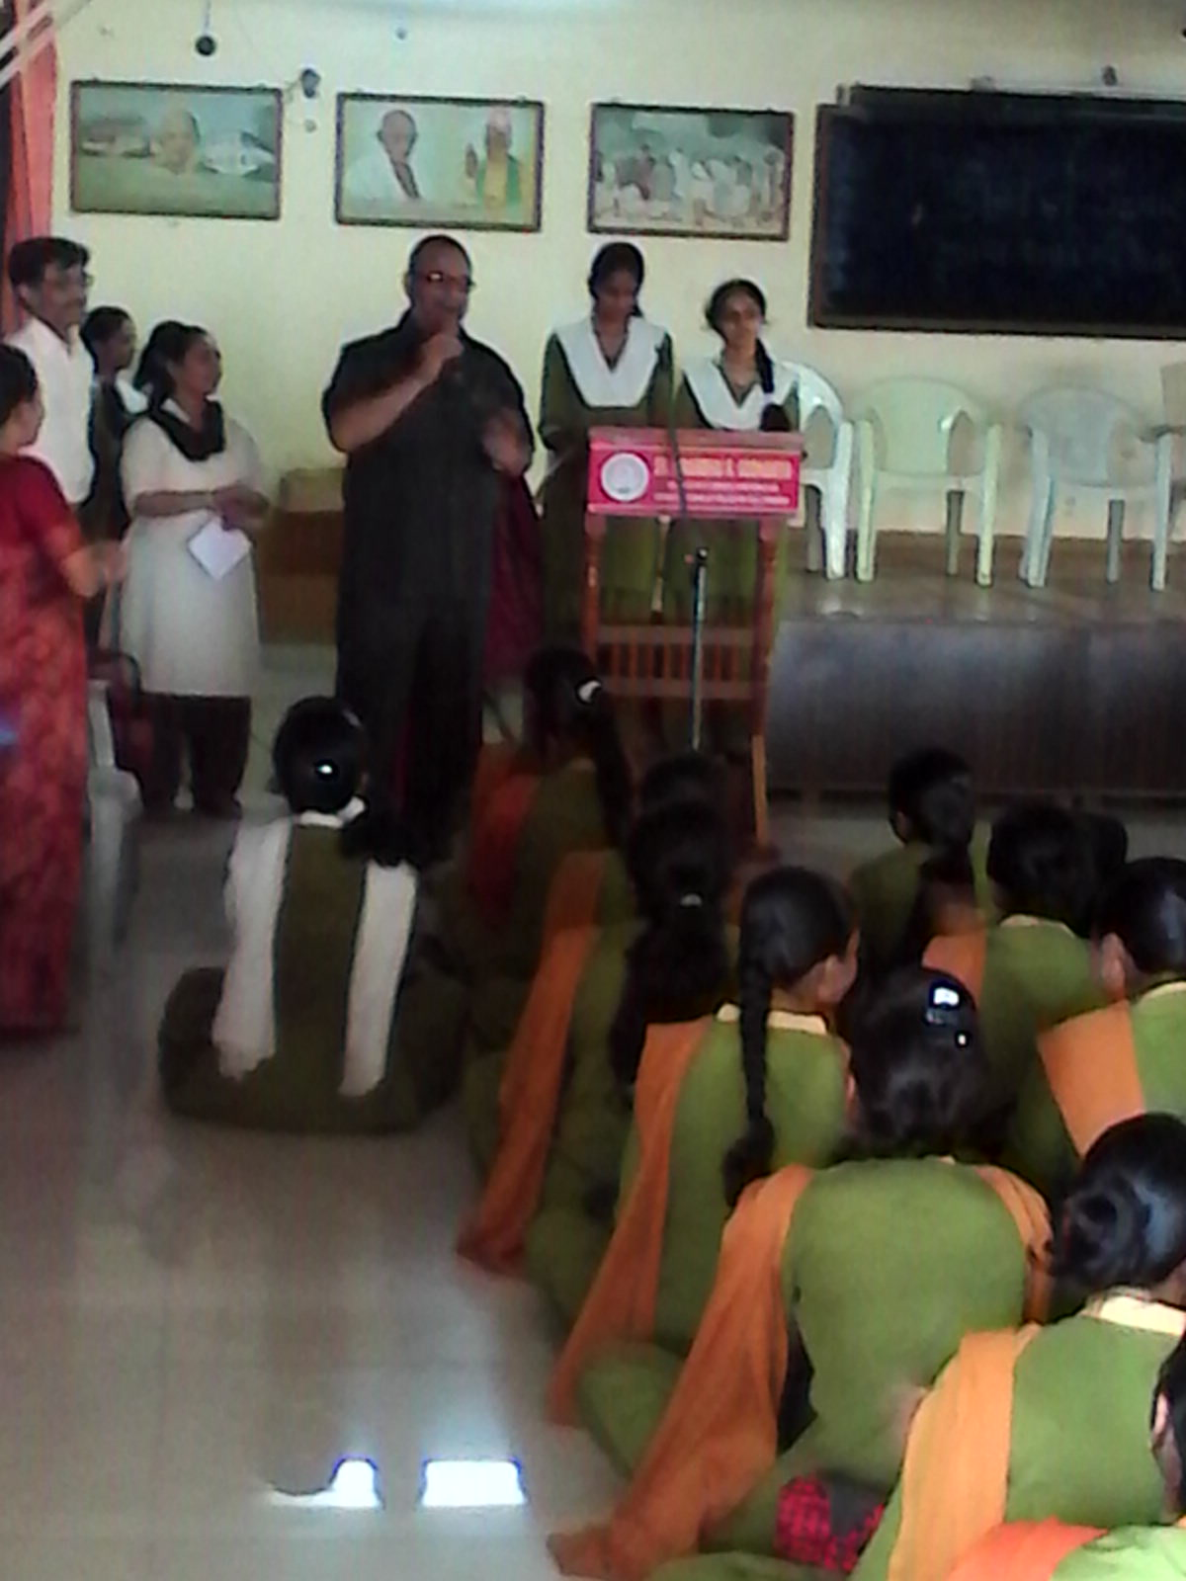
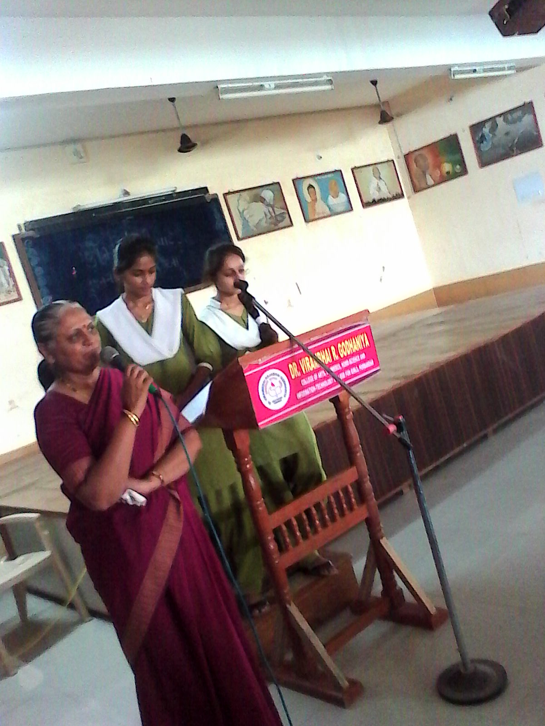
Principal Dr. Nagrsir
Saptadhara Convener: Sh. Chetnamadam

Slide 16
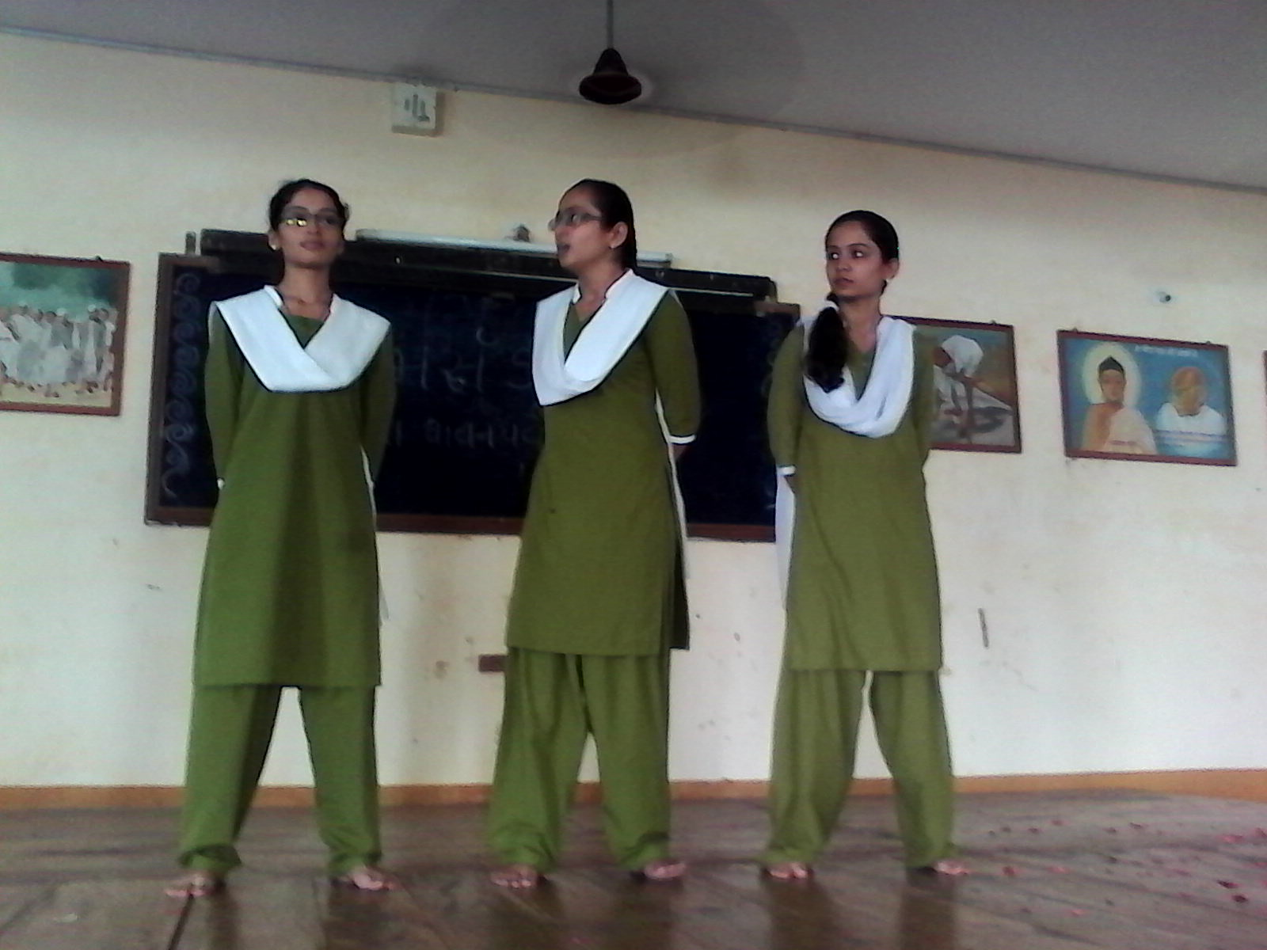

Slide 17
12/8/2014
Independence Day Celebration
Characterisation of Great National Leaders
Atara Divya
Jadav Namrata
Bokhiriya Ridhdhi

Slide 18
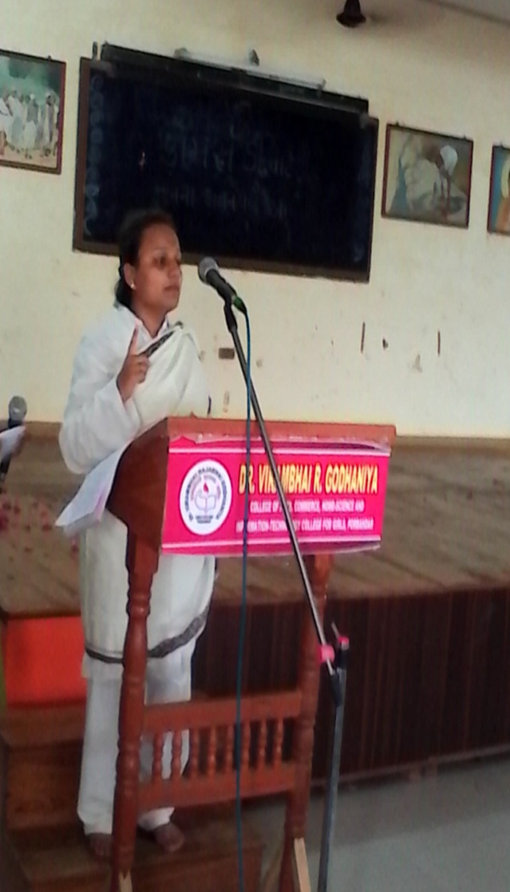
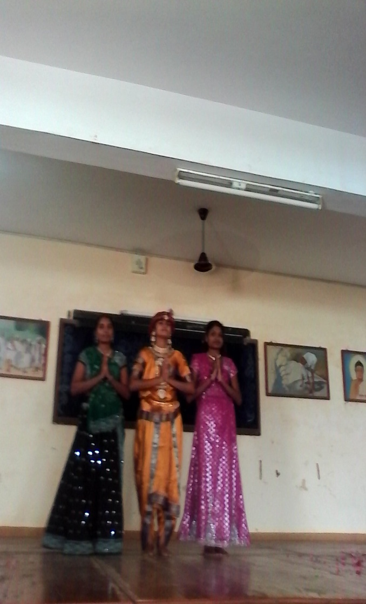
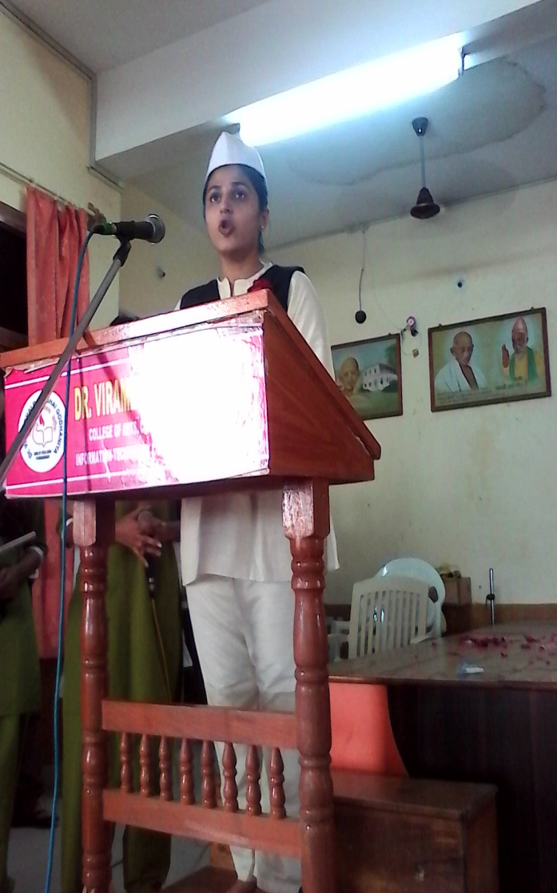

Slide 19
12/8/2014
Independence Day Celebration
Presentation on Freedom Movement
Ankita, Hiral, Kajal, Neha, Bhavisha, Namrata, Bhavika, Nainika, Lakshmi, Rakhi, Dhruti, Surbhi, Salma

Slide 20
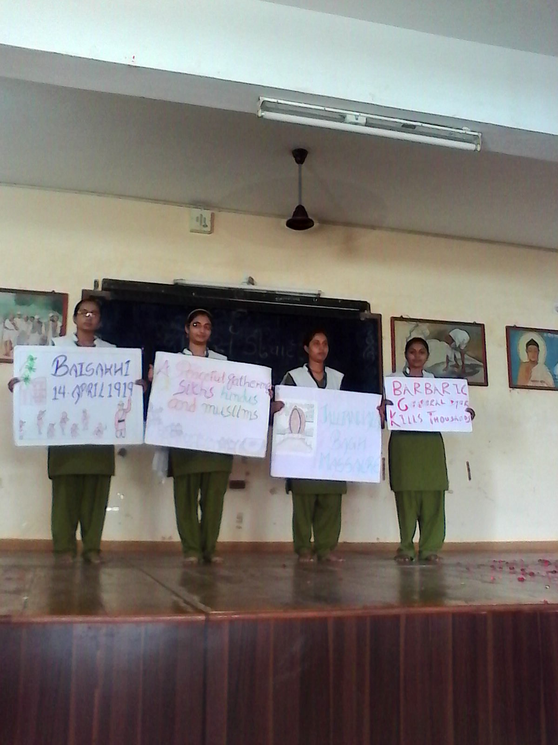
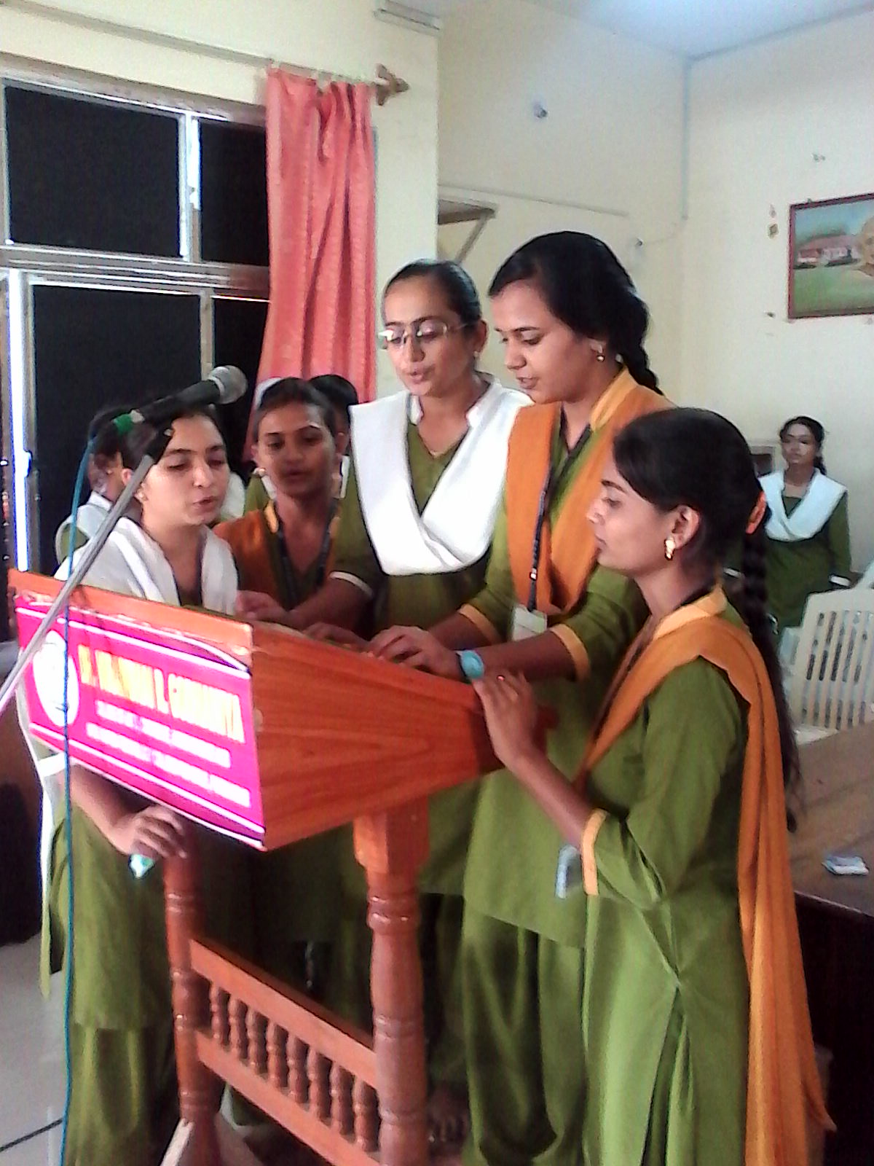
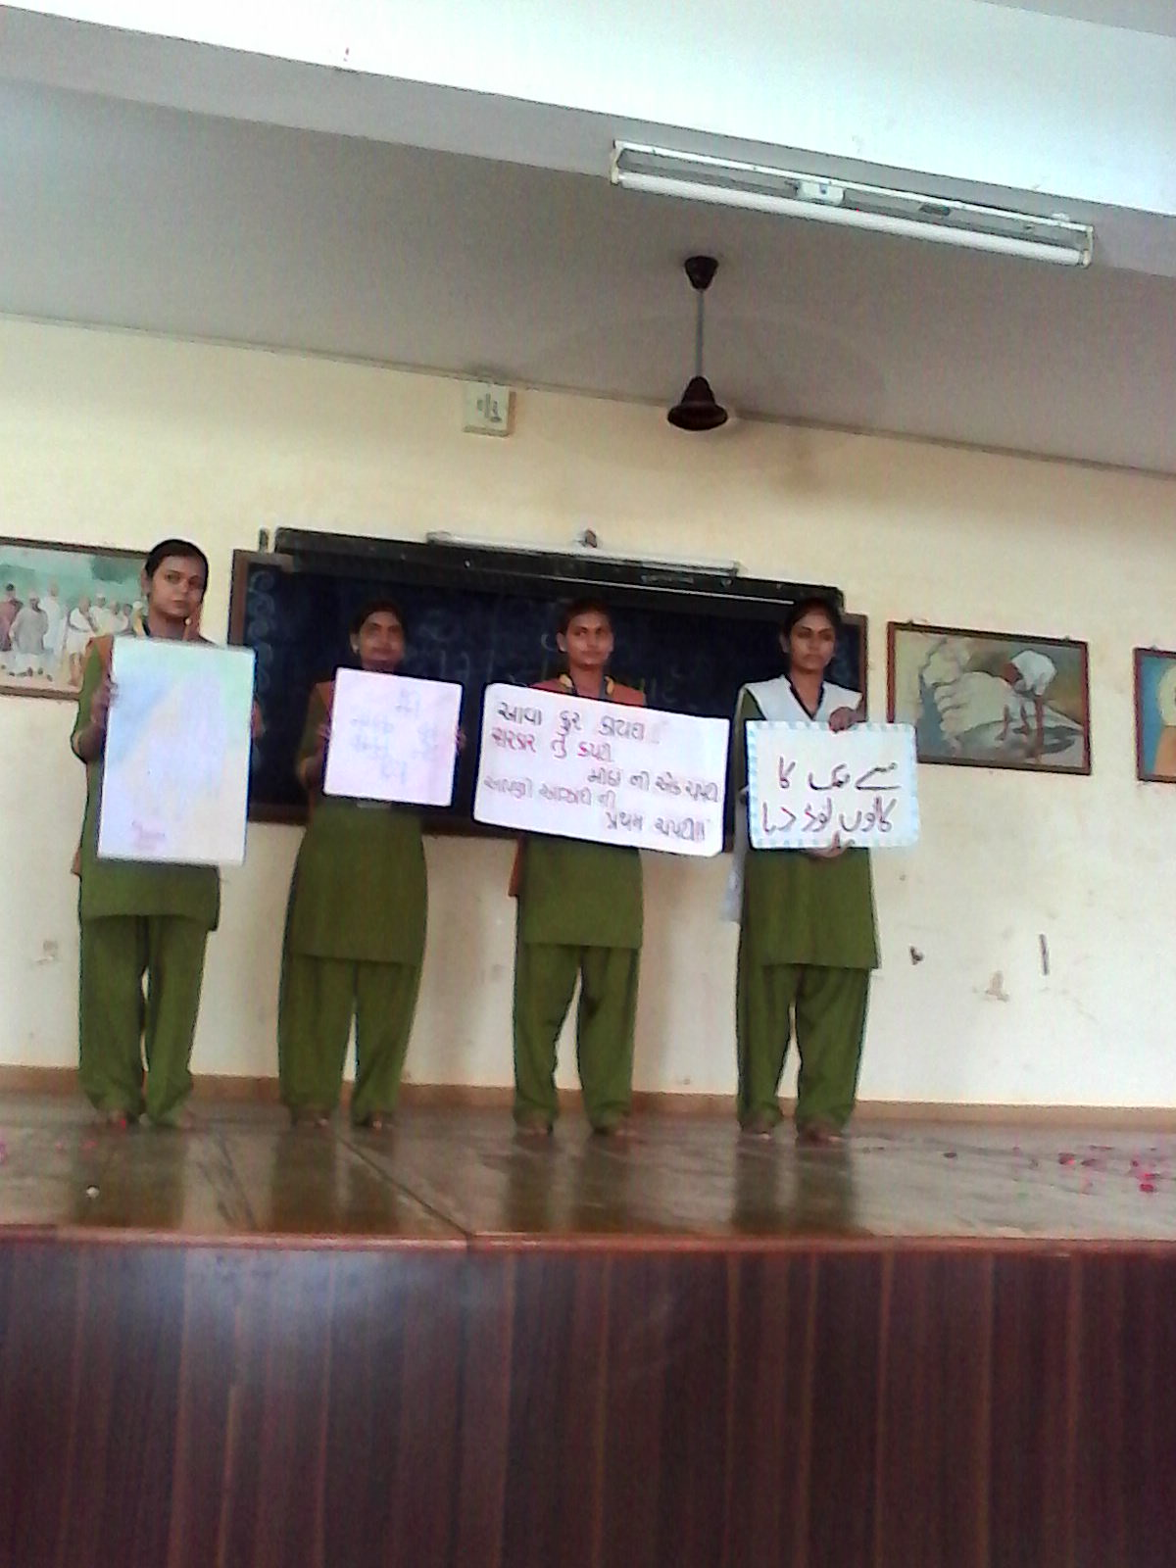

Slide 21
2/9/2014
Drama
“Bholaram ka Bhagvan”
Directed by:
Shree Chetanbhai Dave
Participants:
Shivangi, Namrata, Mital, Kunjana,
Ishita, Dipa and others

Slide 22
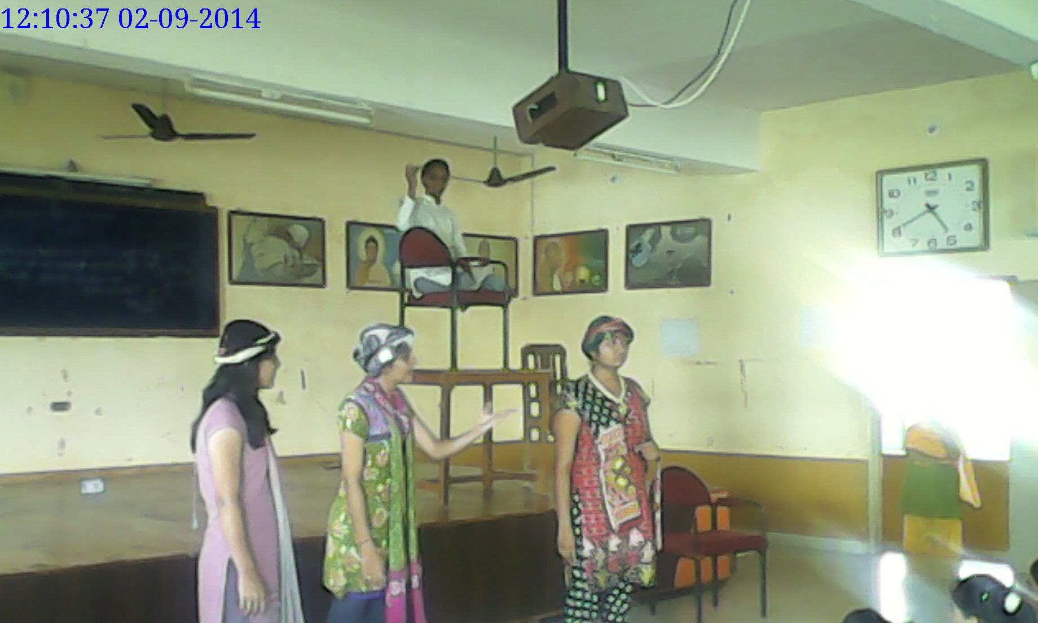
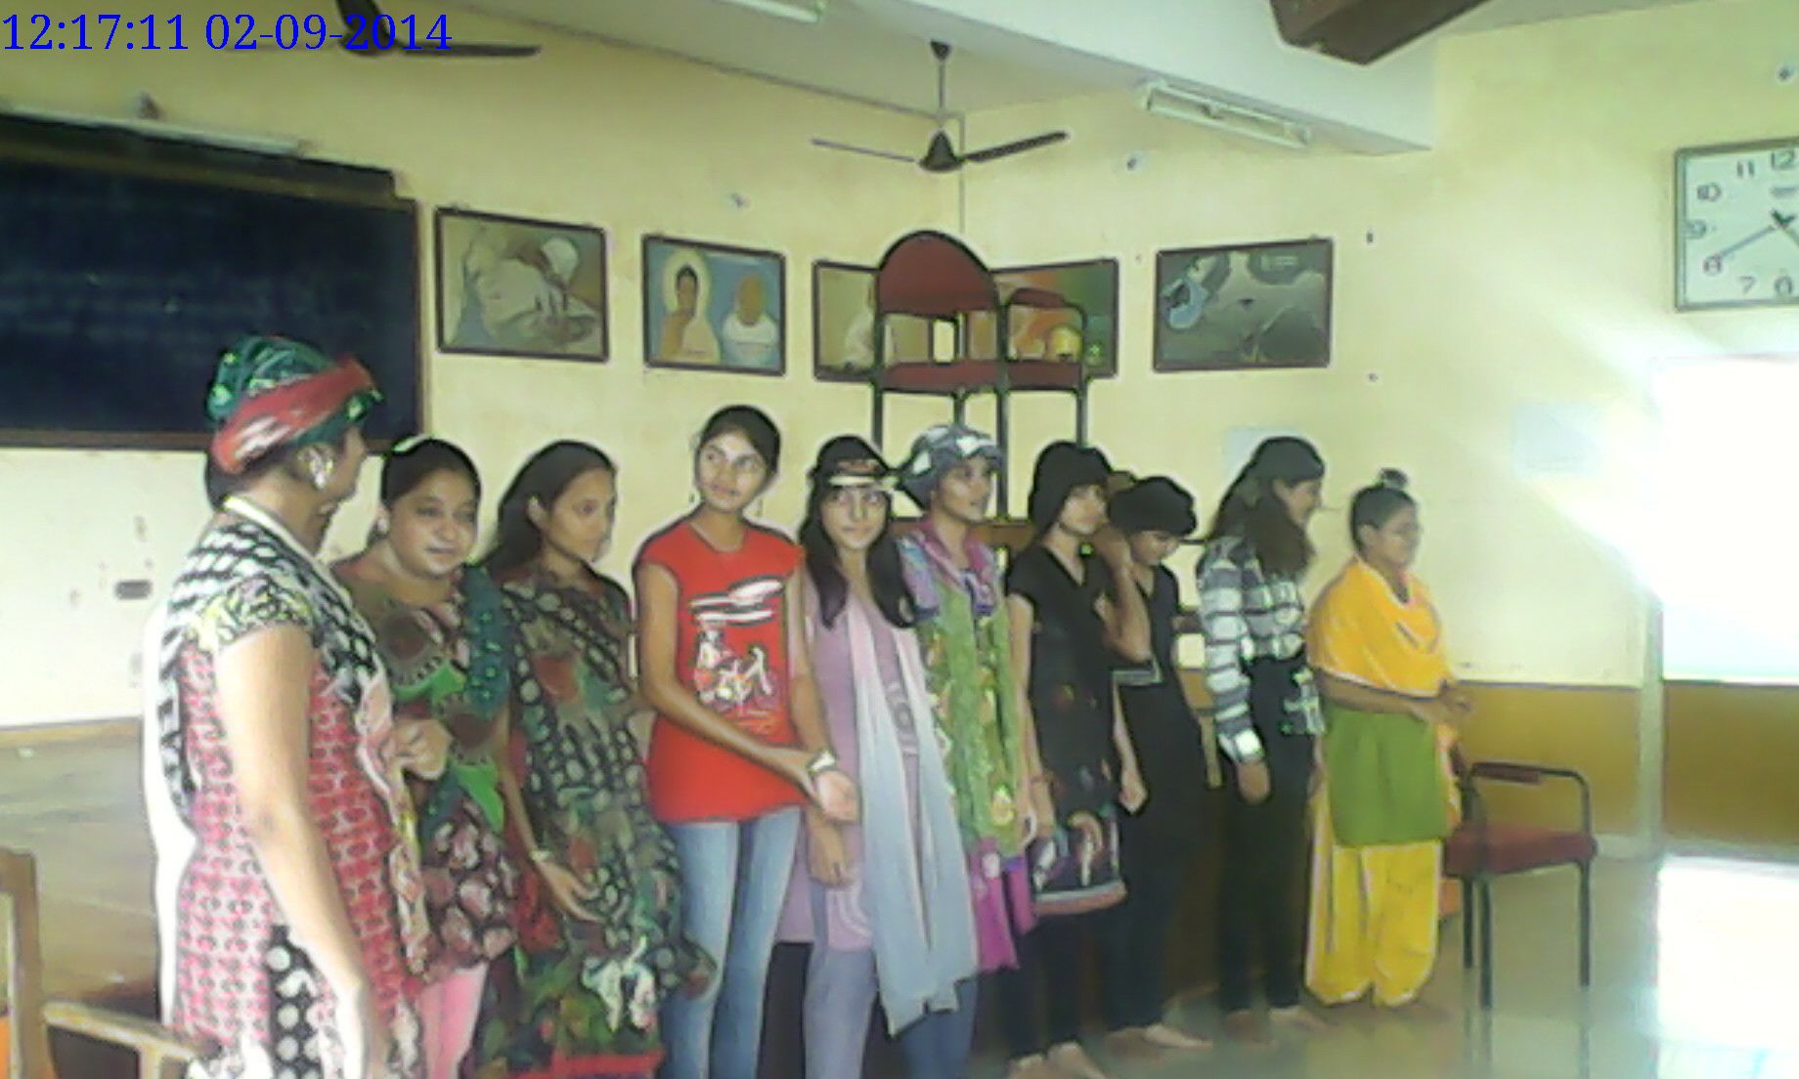

Slide 23
2/9/2014
‘Knowledge Week’
Reading Activity
Reading from books on
Gandhiji, Gram Swaraj
in Gujarati, Hindi and English
Surani Hina, Atara Divya, Pankhaniya Ekta,
Dhokiya Bhavna, Amlani Neha, Bhardvaj Pooja,
Ruparel Hetal, Koriya Vaishali, Vaja Arti, Lukka Ridhdhi

Slide 24
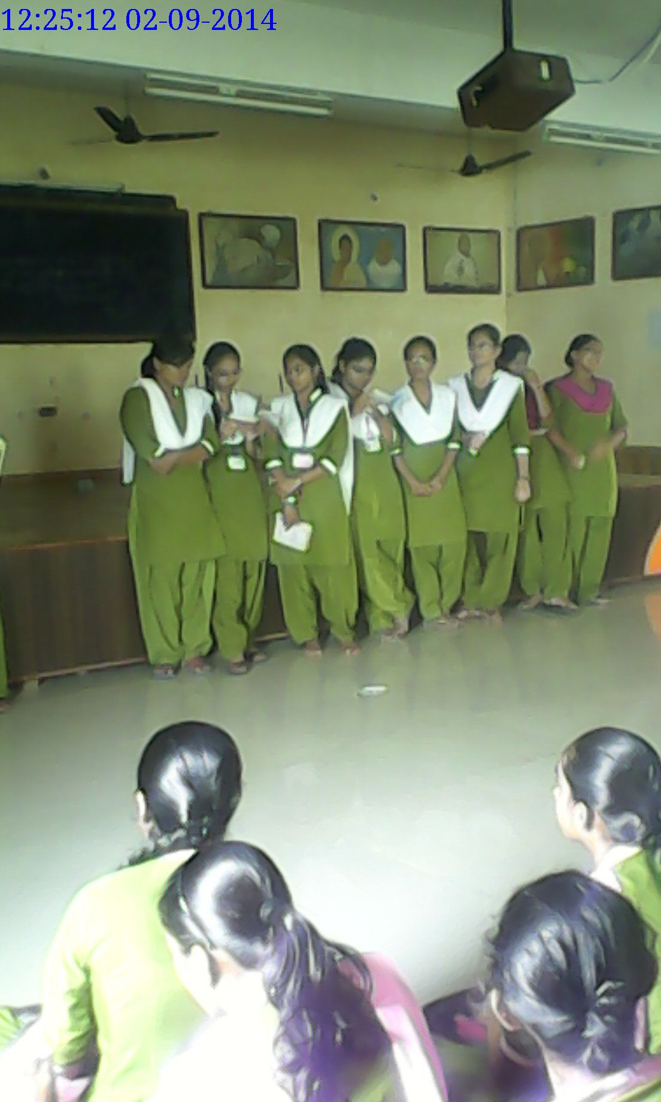
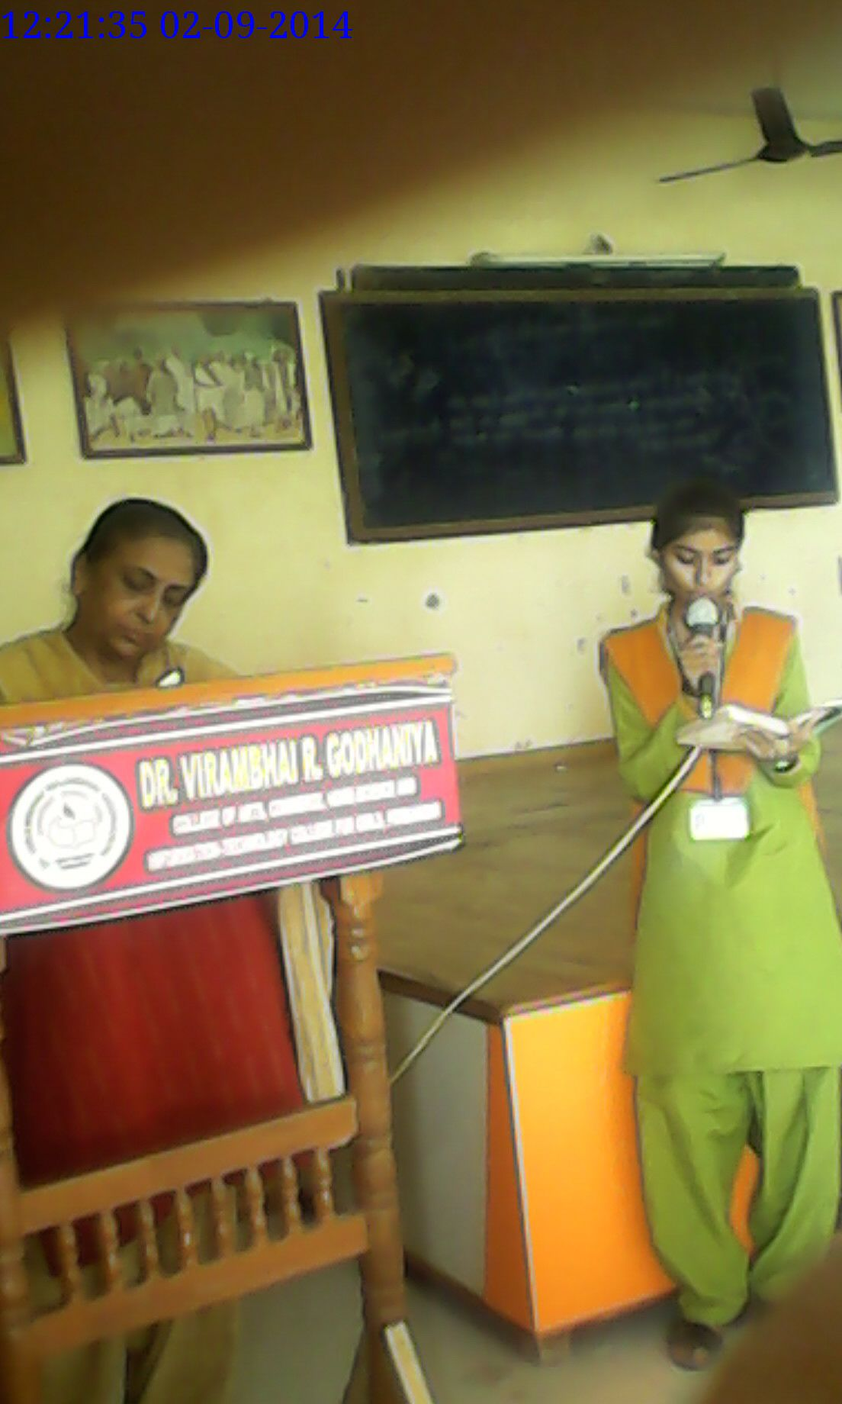

Slide 25
16/9/2014
Expert Lecture on
‘Communication Skill’
&
“Career in Communication”
Sanjay Sharma, Virag Pandya,
Virendrasinh Vala, Ayub Jikani
Videocon Co.-mobile service provider

Slide 26
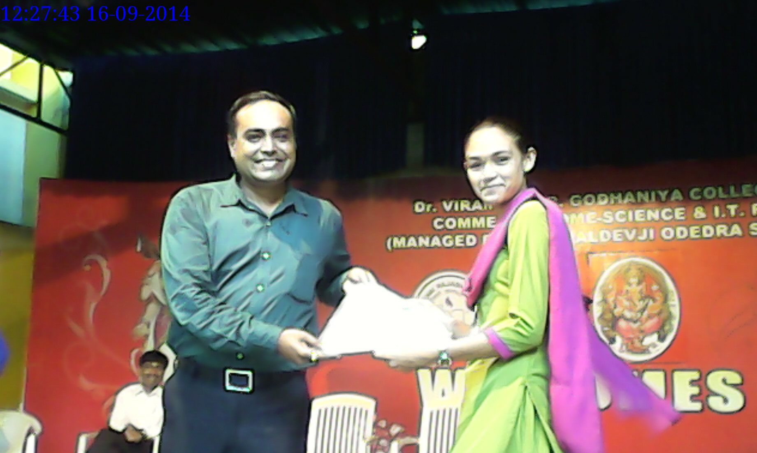
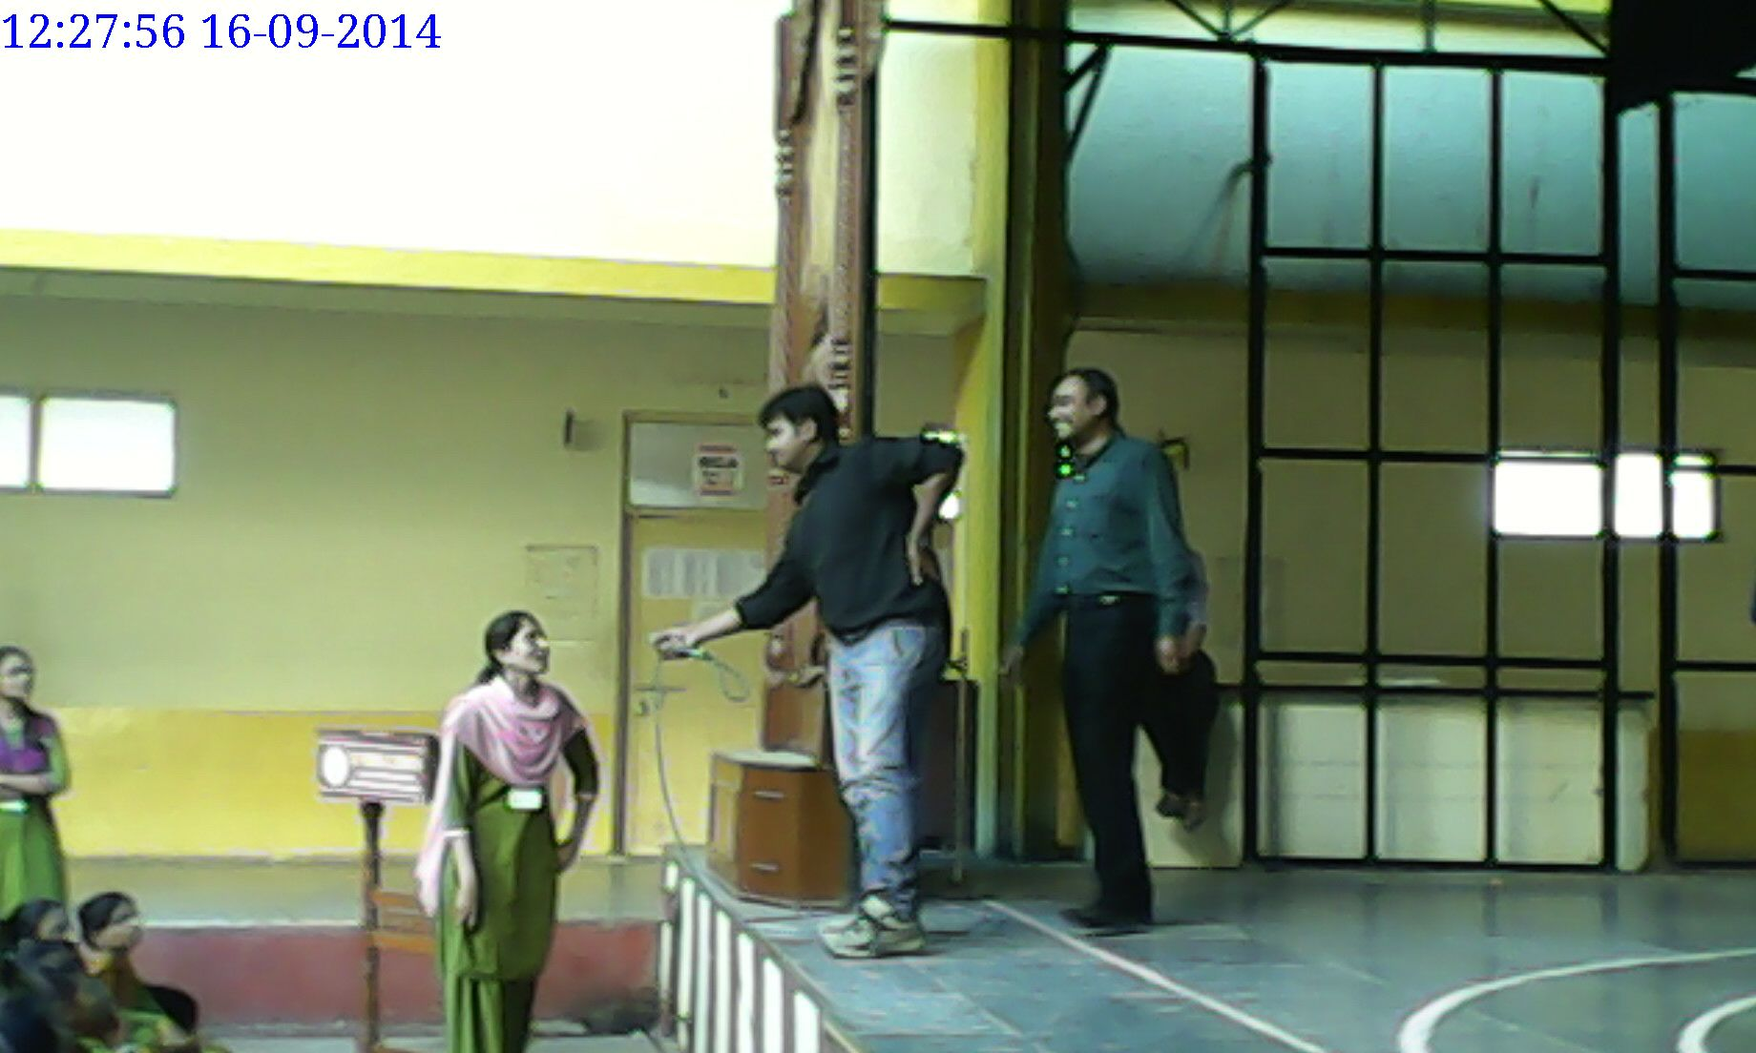

Slide 27
1/10/2014
Drama:
‘Swachchha Ghar’
(a self-written and self-prepared
short performance by students on
the importance of cleanliness at homes)
Krupa, Nayana, Shama,
Shamshad, Ayushi, Puja, Krushnika

Slide 28
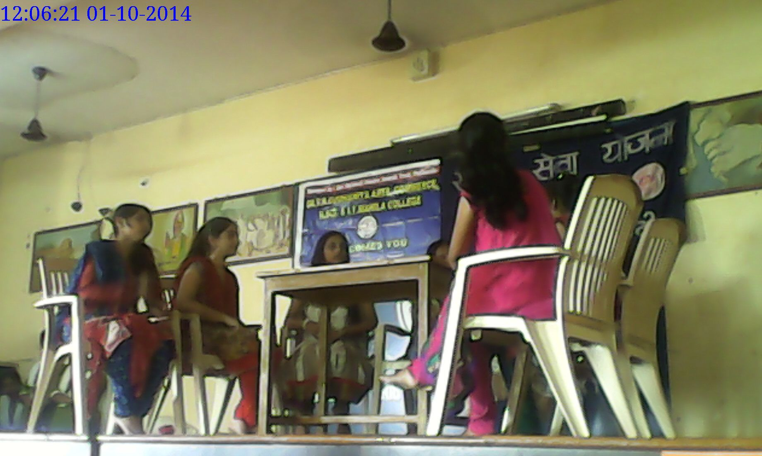

Slide 29
1/10/2014
Performance on a message:
‘Clean Country,
Prosperous Country’
( a message: what to do and not to do
to keep cleanliness around us)
Hirali, Ekta,
Nirali, Dhara, Lilu

Slide 30
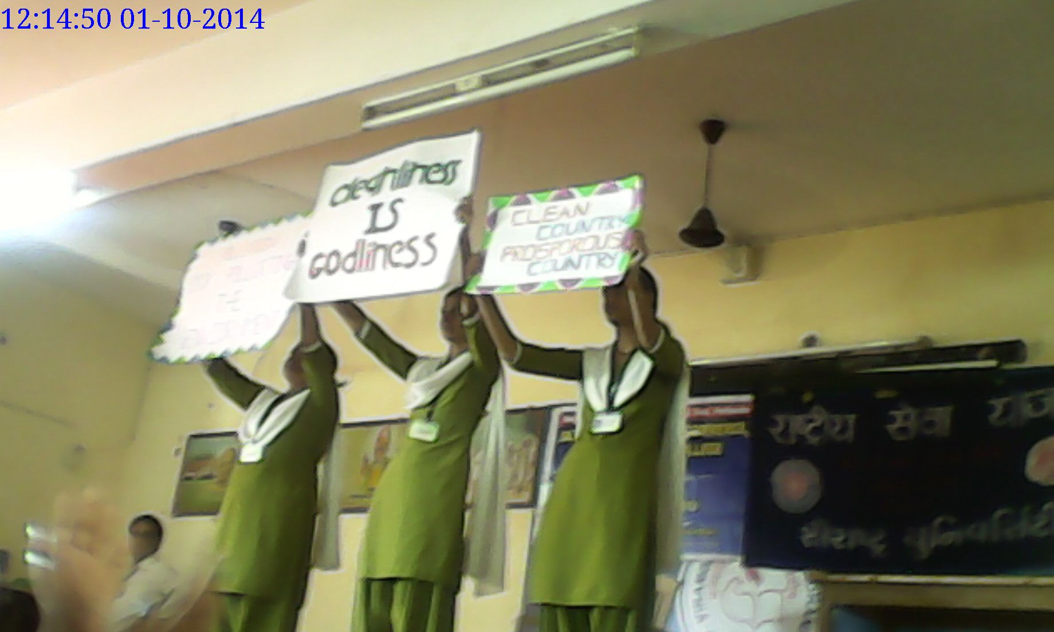

Slide 31
1/10/2014
Poster Exhibition:
‘Cleanliness’
Inaugurated by our respected trustee
Smt. Jayashreemam,
in the benign presence of
our working trustee Sh. Visana sir
and Principal Dr. Nagarsir.
under guidance of
HOD (Dep. Of Com.-Eng. Med.) Kalpanamam.
23 posters prepared by students
were selected and exhibited.

Slide 32
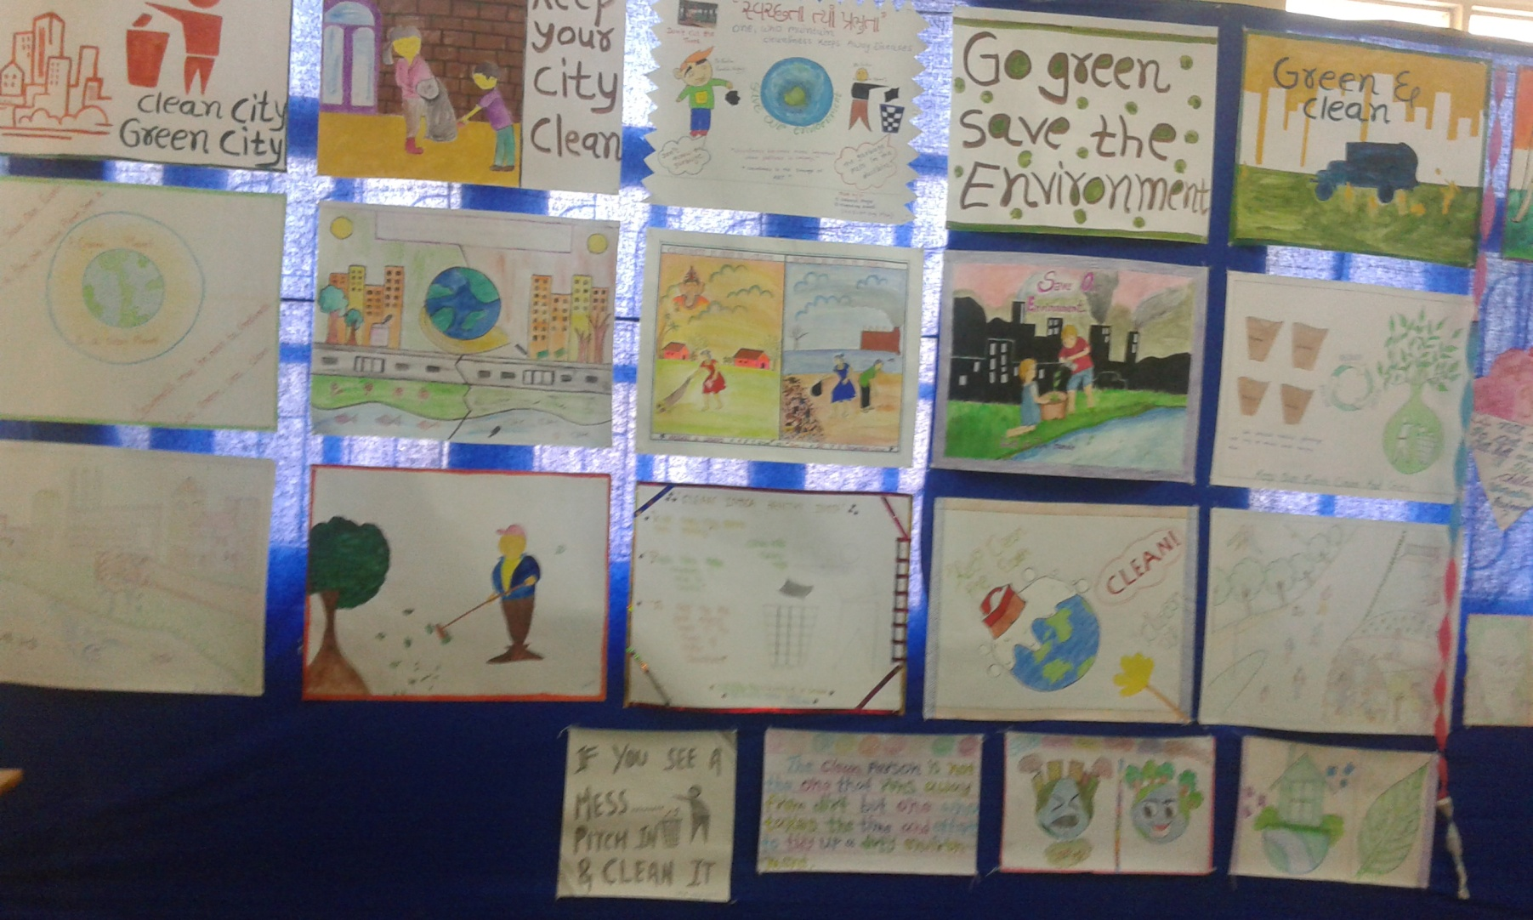

Slide 33
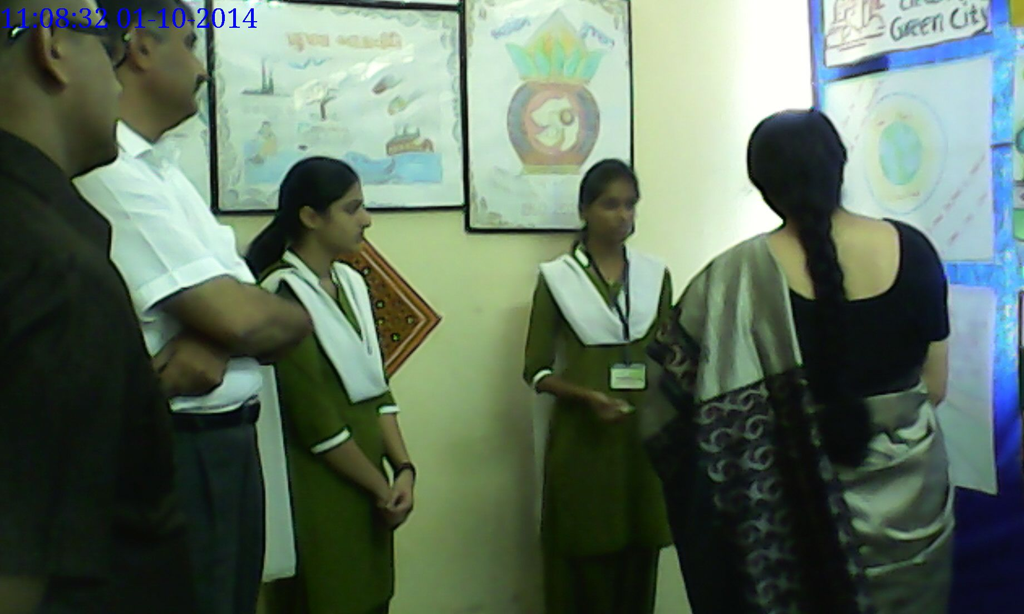

Slide 34
7/10/2014
Stories
by
Chandnimam, Mitalmam
and students
A simple informal activity
with an objective to encourage students
to speak to an audience.

Slide 35
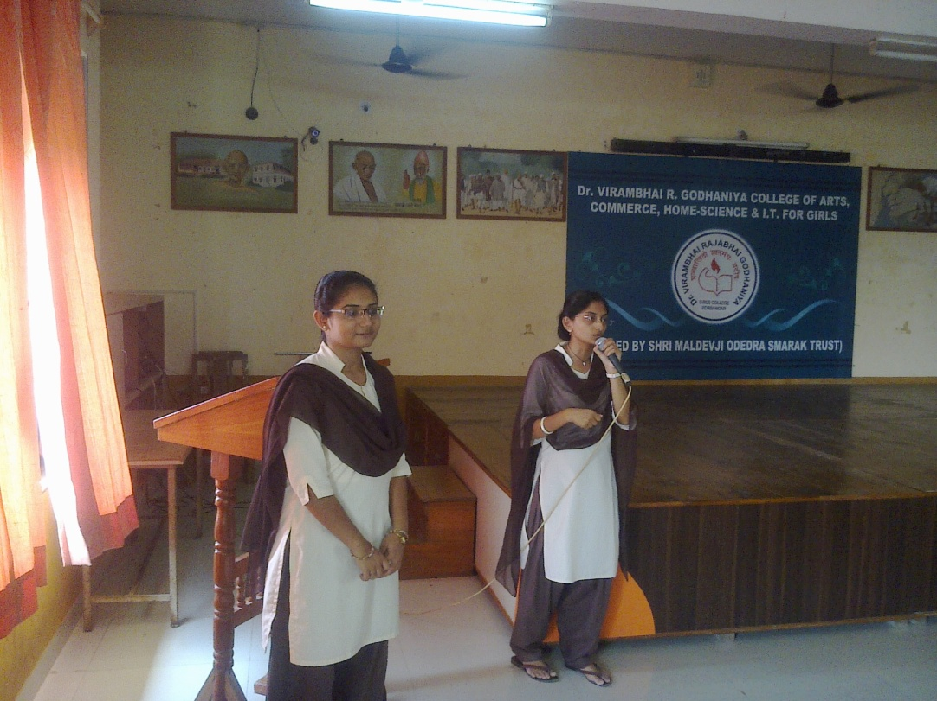
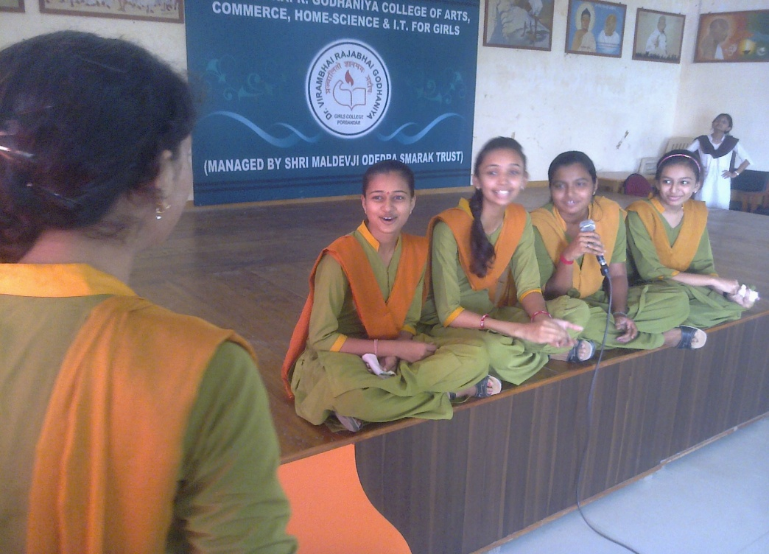
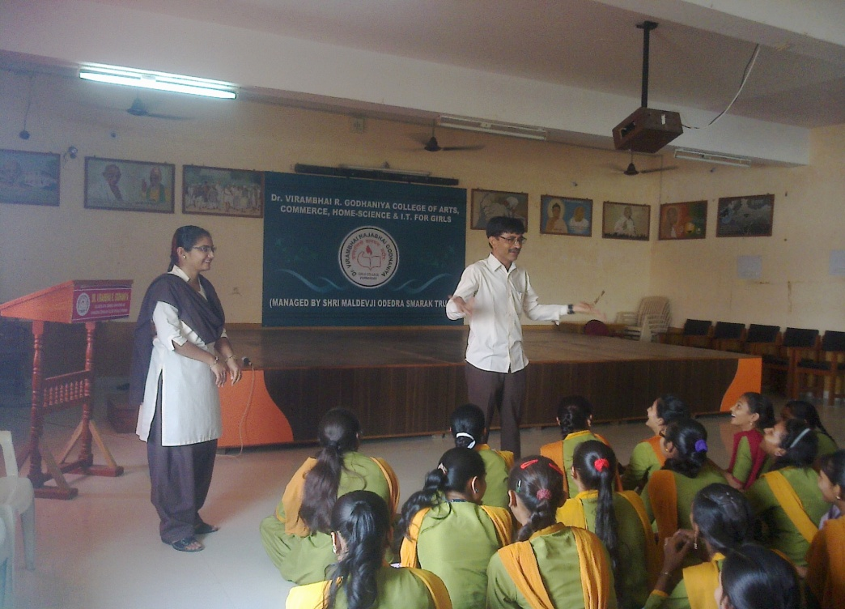

Slide 36
9/12/2014
Certificates Distribution
For the activities and winners
Ad-mad show
Co-ordinated by: Jankimam, Mitalmam

Slide 37
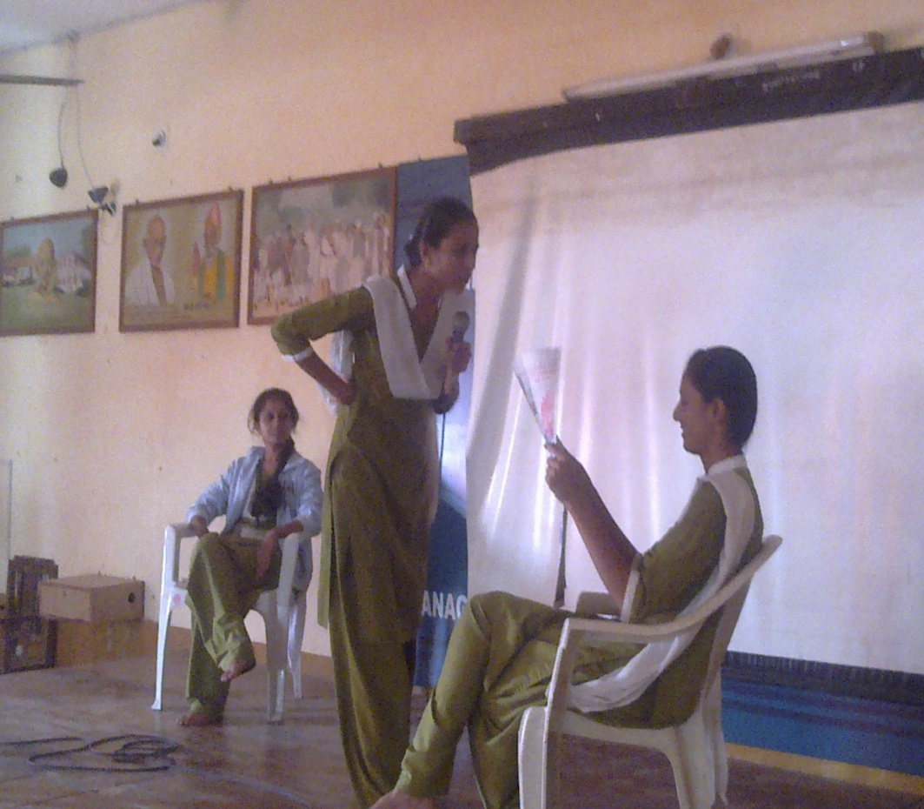
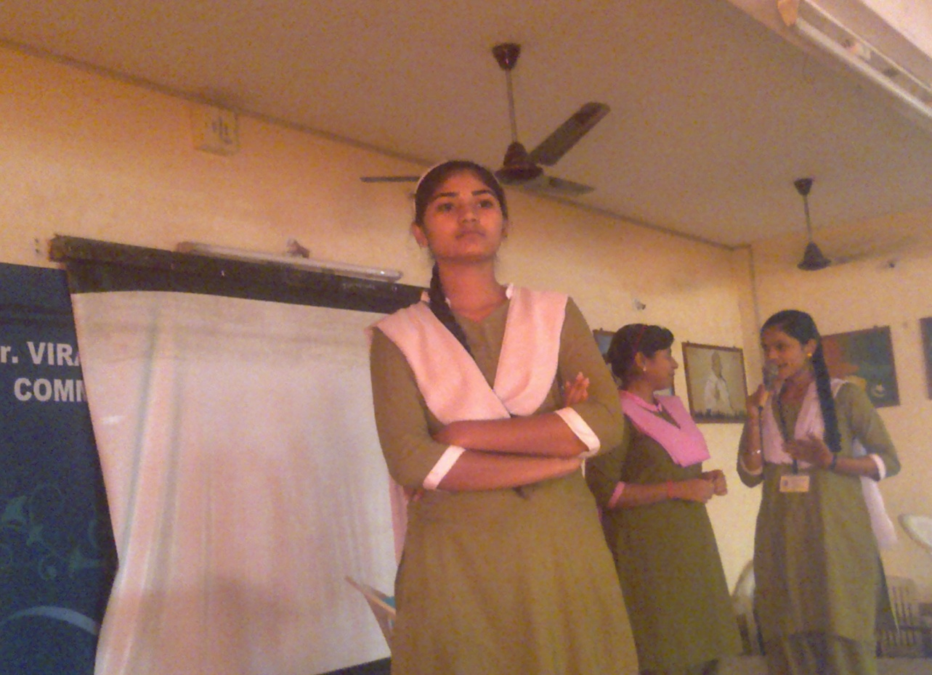
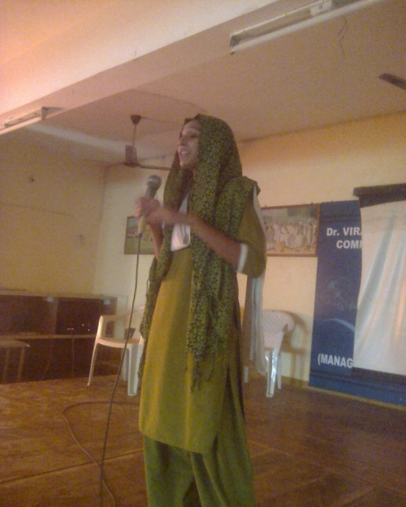

Slide 38
23/12/2014
Documentary:
“Life of Budhdha”
A dramatised documentary
on the life of
Bhagvan Shree Budhdha
Help in AV presentation:
Rushisir, Chandanimam

Slide 39
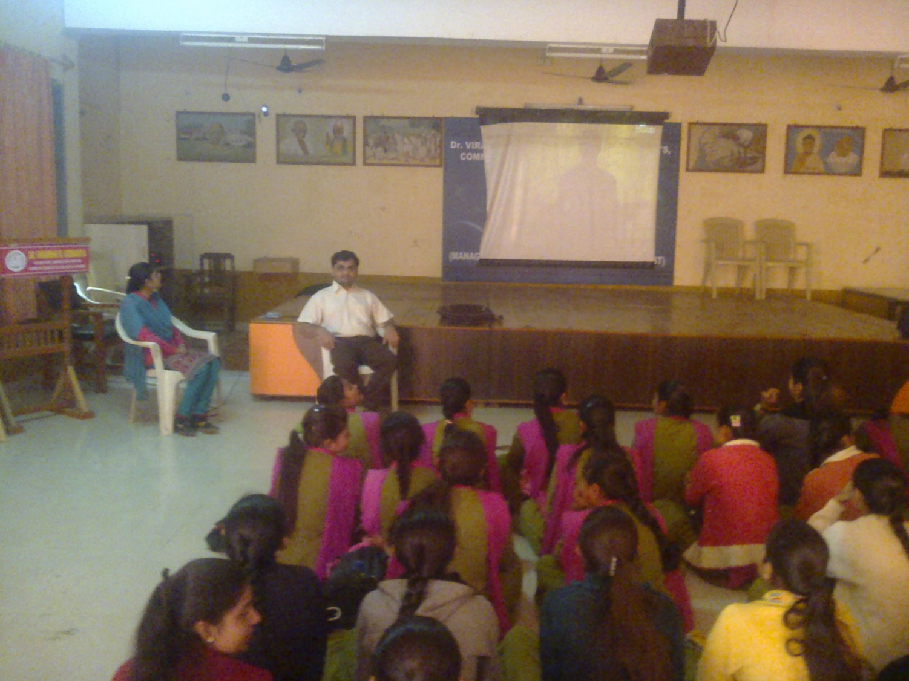

Slide 40
23/12/2014
Seminar:
Career in Animation
By Xplora Institute
(Ahmedabad centre)
Theme:
The potentials in animation industry in future
An option in choices after graduation

Slide 42
13/1/2014
Drama:
“Ridd Ki Haddi”
S Y BA
(Hindi)
Vaishali & group
Underlined theme: Problem of Dowry

Slide 43
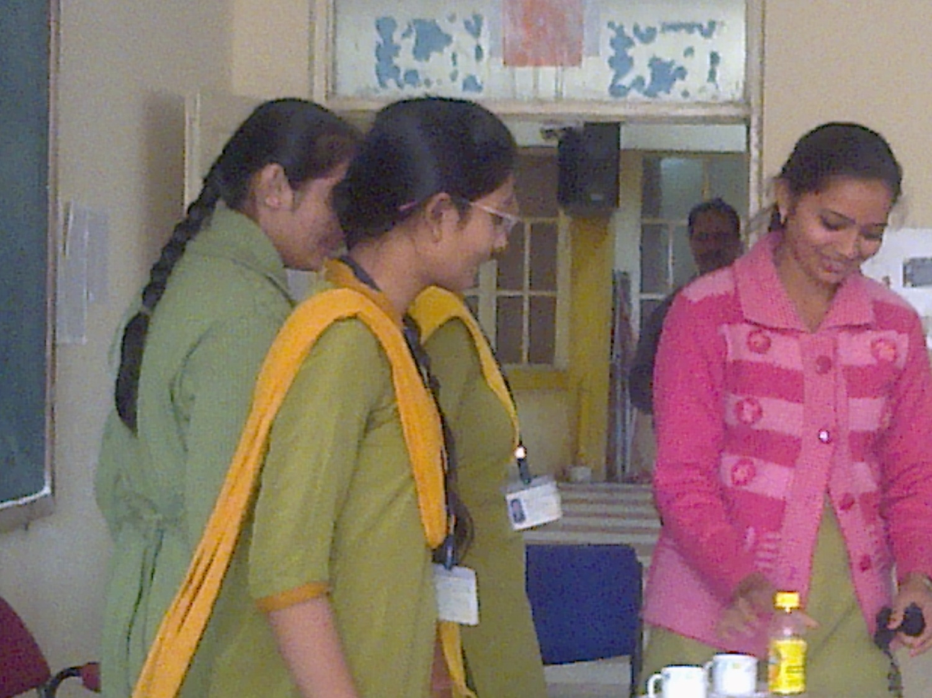
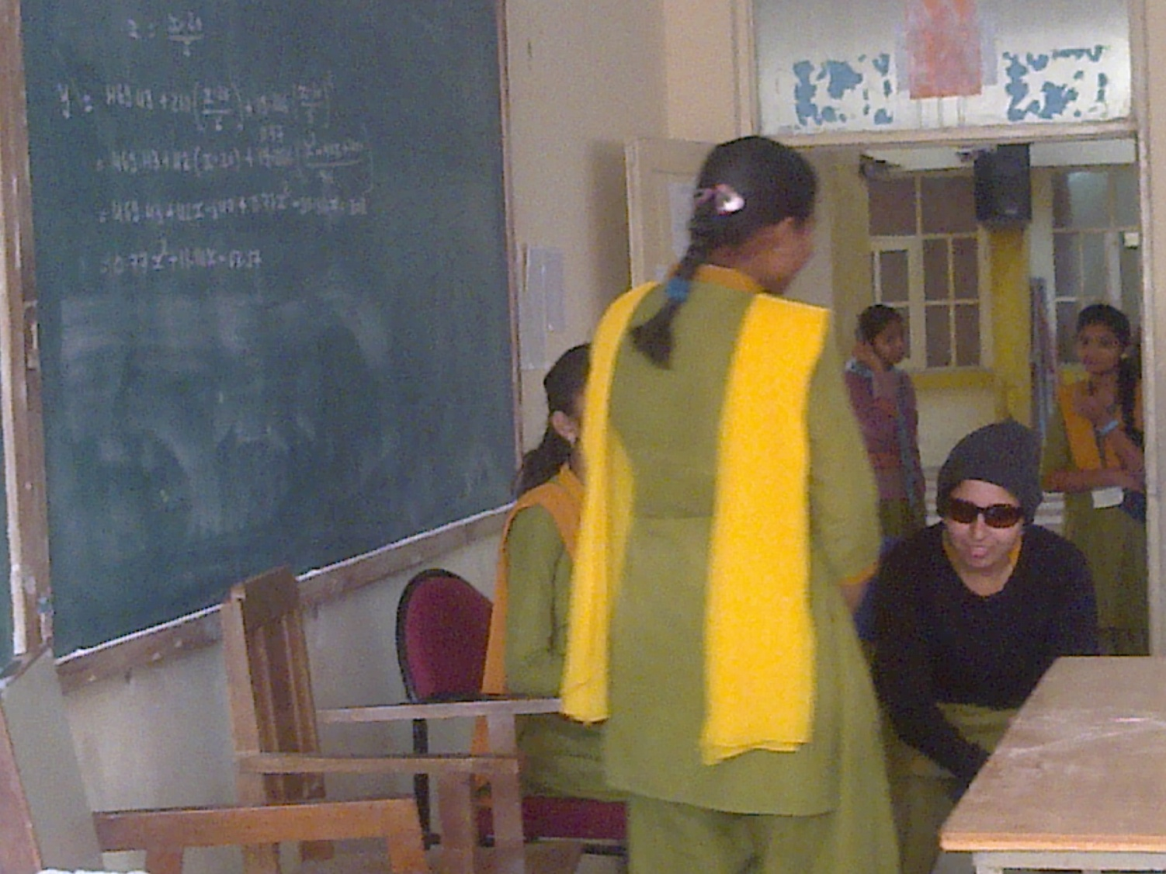

Slide 44
13/1/2014
Drama:
“Chorasi Lakh No Fero”
Directed by:
Shree Chetanbhai Dave
Deepa, Priyanka and others

Slide 45
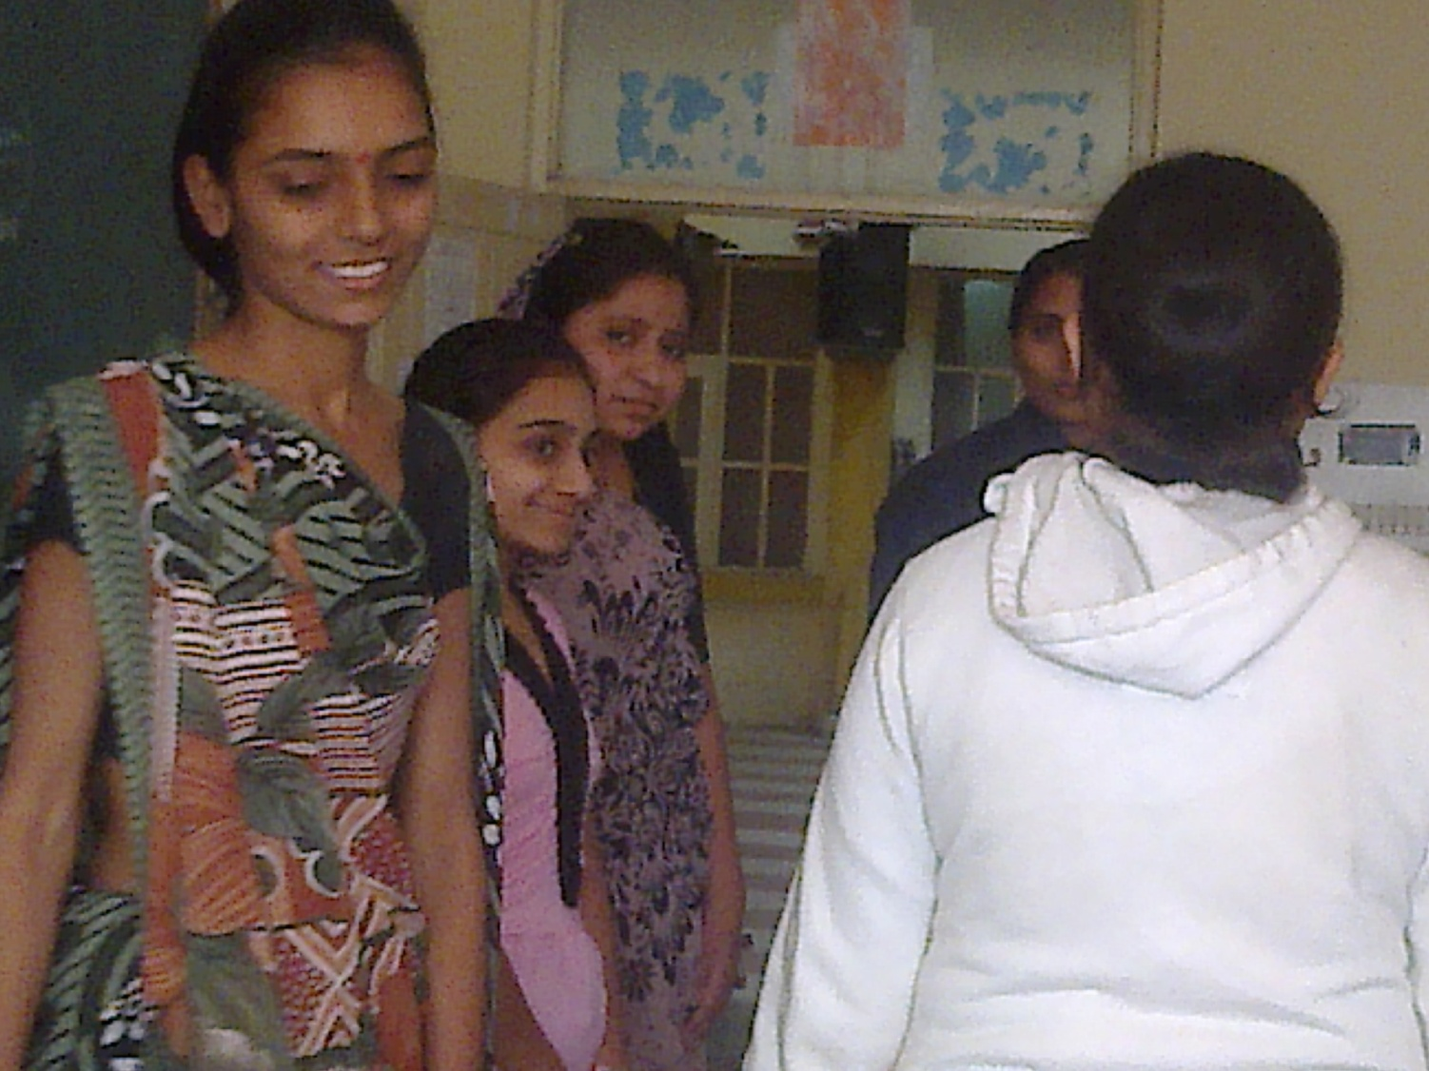

Slide 46
13/1/2014
“Add-a-Line”
A group activity
in which a sentence is given to each group
and ask them to add sentences one by one member to create a story.

Slide 47
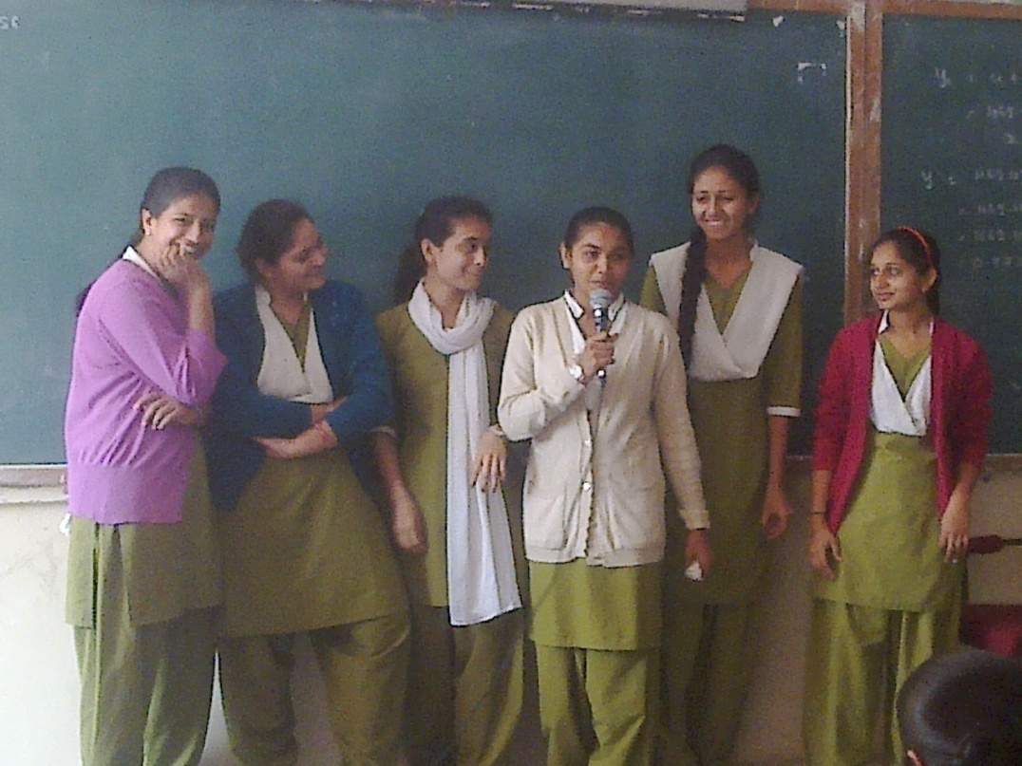
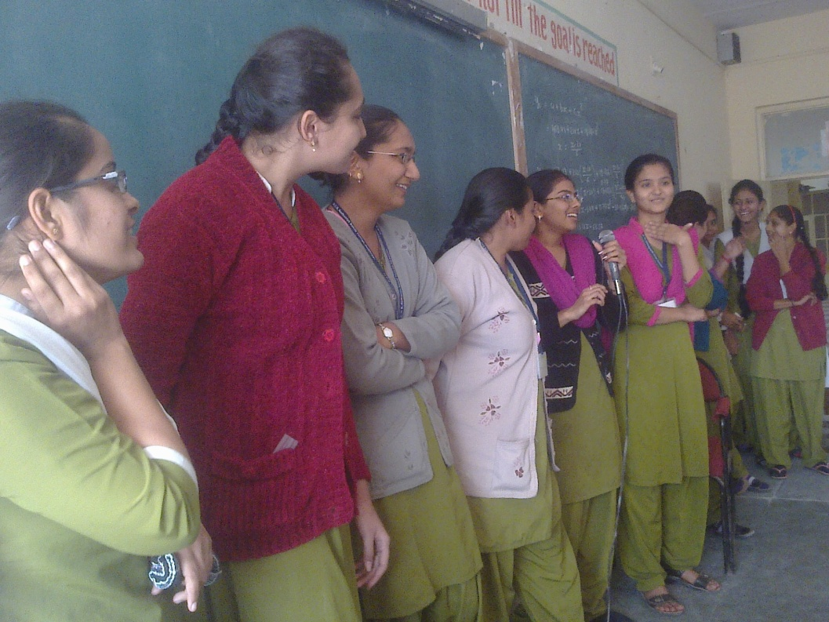
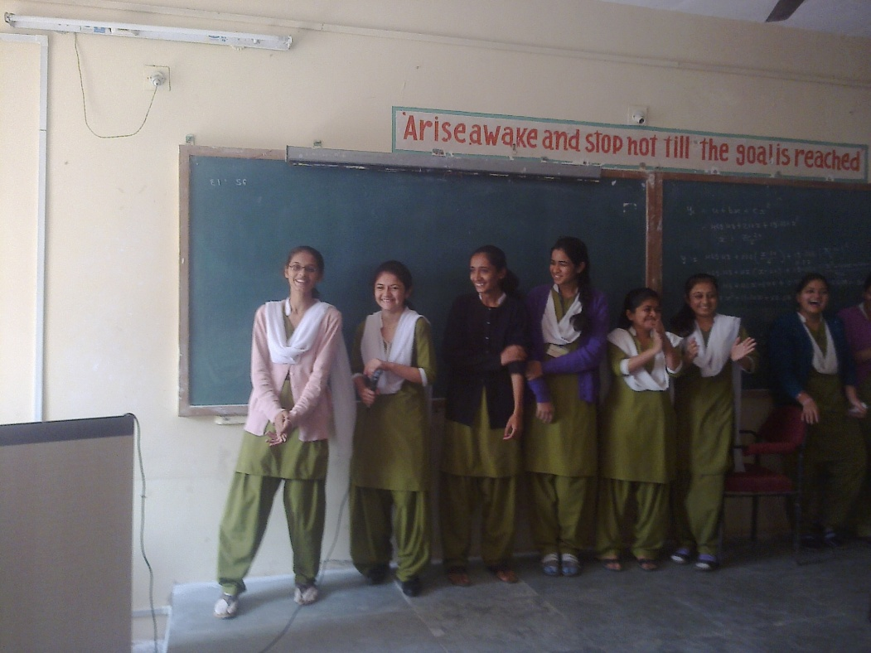
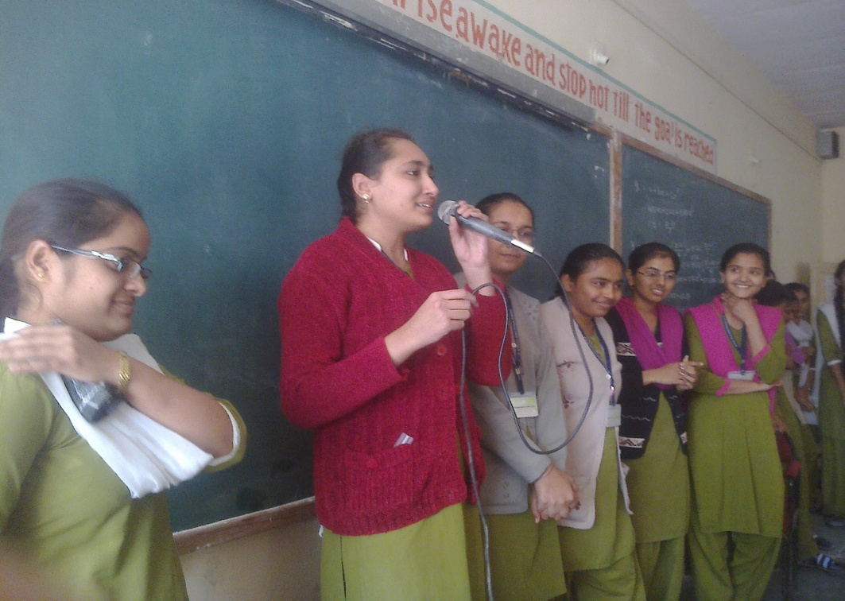

Slide 48
27/1/2014
Story of a classic drama:
Macbeth
Presented by:
Dr. Sulbhamam Devpurkar
(Dep. Of English)

Slide 49
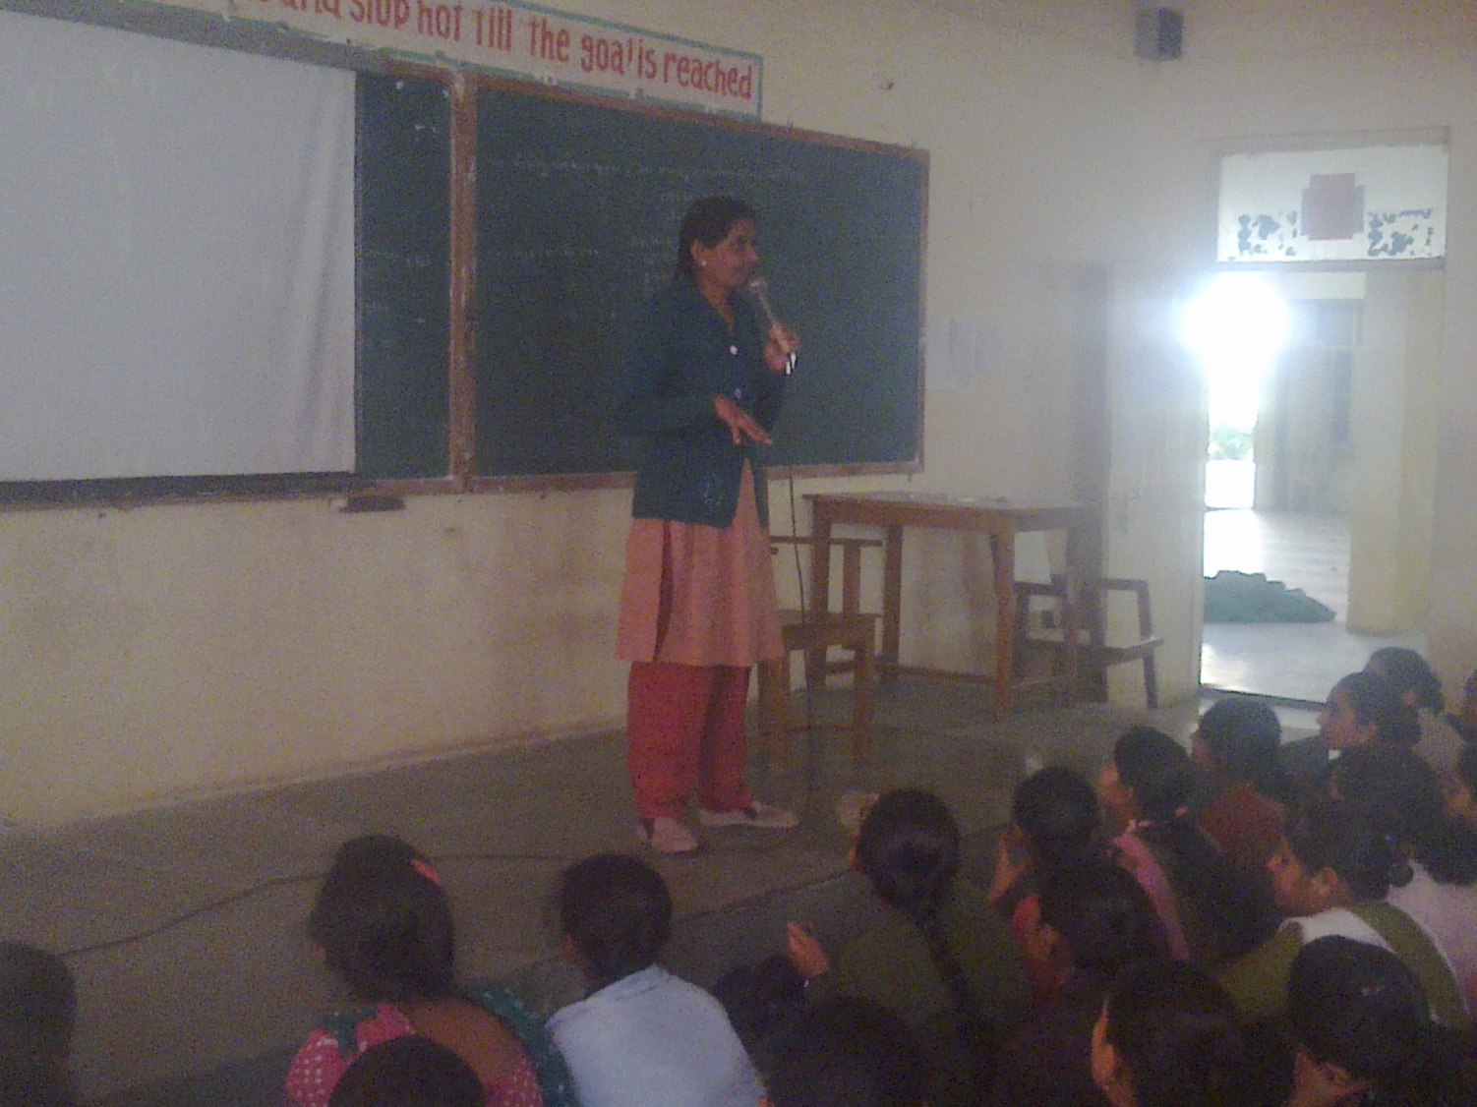

Slide 50
27/1/2015
Short Movies on
“Voting Right”
Directed and presented by:
Shree Chetanbhai Dave
Ranked and awarded at district level
competition held by the collector office

Slide 52
10/2/2015
Hindi movie:
“Haider”
based on Shakespeare’s
Drama- ‘Hamlet’

Slide 53
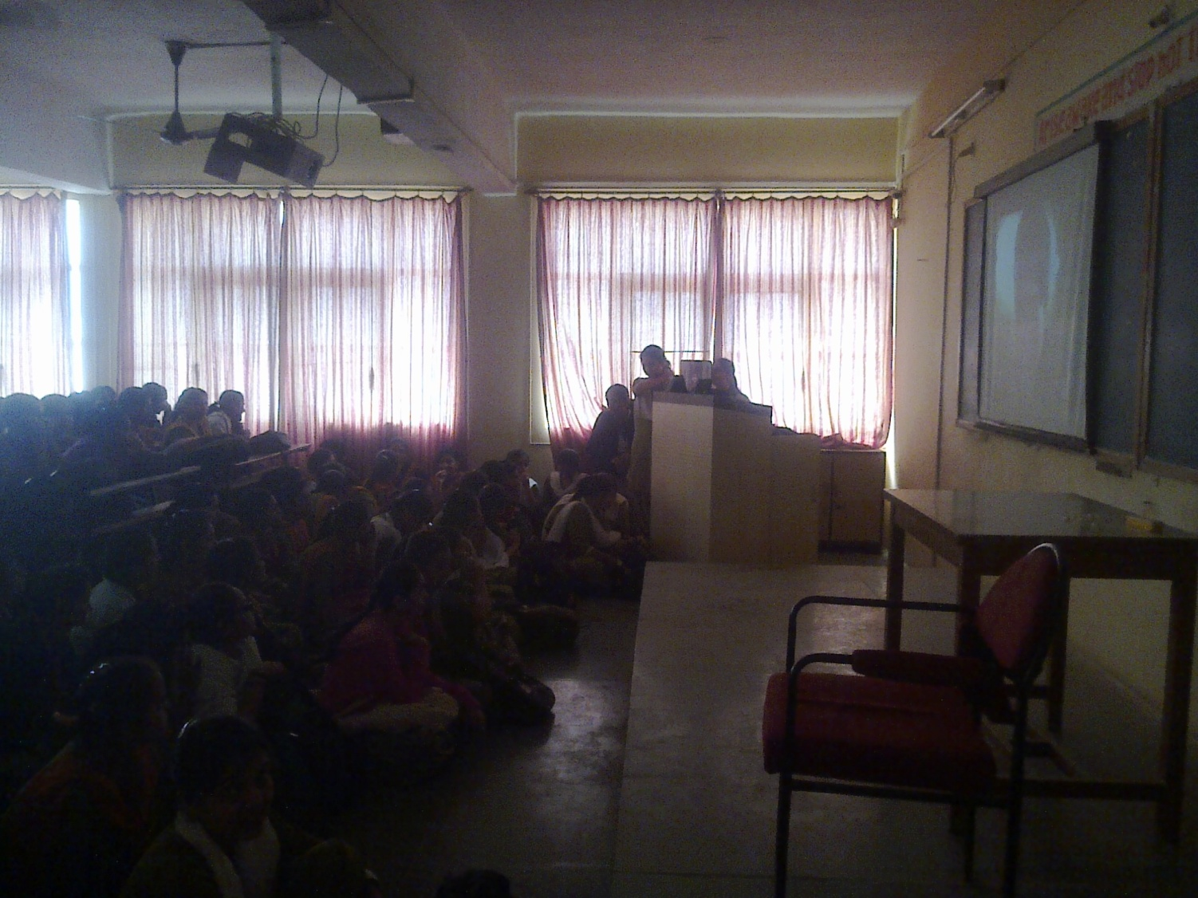

Slide 54
3/3/2015
Gujarati Movie:
Be Yaar
a most appreciated Gujrati movie in recent times
Story woven around a father’s values,
a painting, a cheating and a collegian-friendship.

Slide 55
